Slide 1
Computer Networks (Lab1)
Basic CN commands & Wireshark Software
List of basic CN Commands:
Ping command
Ifconfig command
Traceroute command
Netstat command
Hostname
NOTE: These commands may vary a bit in windows operating system.

Slide 2
Ping command
The full form of ping is the Packet Internet Groper.
ping is the primary TCP/IP command used to test the network connectivity between two systems, say the host and the server.
It sends a data packet to the address specified in the arguments as an echo message and the server on receiving the packet sends it back as the echo reply response. If not specified, it sends packets of default size.

Slide 3
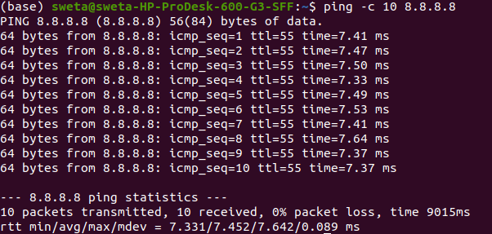
Cont..
Note: 8.8.8.8 is the ip address of www.google.com

Slide 4
Ifconfig command
ifconfig command is used to configure the kernel-resident network interfaces.
It is used to assign the IP addresses and netmask to an interface or to enable or disable the interfaces.
It is often advised to use the ifconfig command after starting the system to define the network address of each interface for the smooth functioning of the system.
After the startup of the system, it can again be used for changing the network address of the interface or can also be used for debugging purposes too.

Slide 5
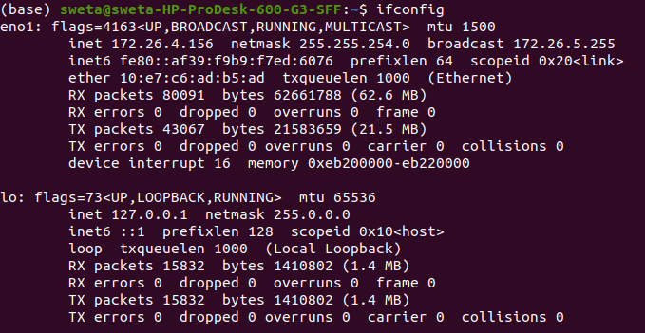
Cont..
Note: 1) MTU stands for the Maximum transmission unit.
2) MTU determines the maximum payload size of a packet that is sent.
Note: 3) inet stands for the Internet protocol family.
4) inet6 stands for the Internet protocol version 6 family.

Slide 6
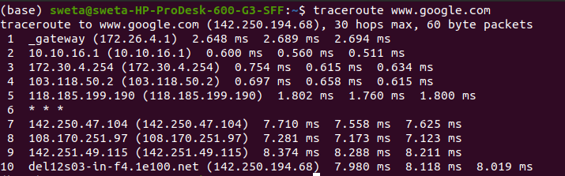
Traceroute command
traceroute command is used to print the path taken by the packet to reach its destination.
This command will show the whole network from our wifi router to the destination ip address.
Note: 1) 10.10.16.1, 172.30.4.254,.... are the required ip address to reach the packets from source to destination.
Note: 2) * * * means that the router at that particular hop doesn't respond to the type of packet you used for the traceroute.

Slide 7
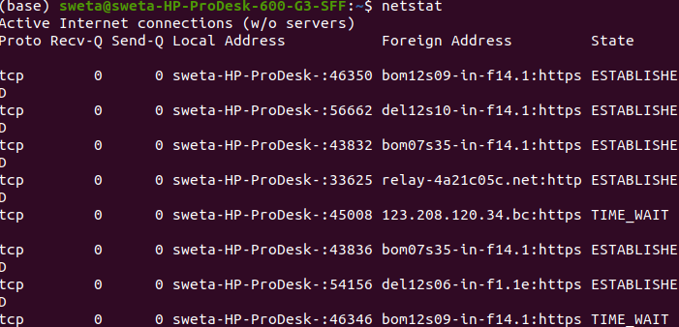
Netstat command
1) netstat command is used to display various types of network-related information such as network connections, routing tables, etc.
2) It is used to display the network status and protocol statistics of the network.
3) It can also be used to display the status of all the TCP and UDP connections.
4) It can also be used to show both listening and non-listening sockets.
Note: 1) Local Address defines the IP address of the local computer and the port number being used.
2) A foreign address is an address that's not in the same network that you are.
3) Recv-Q means the data is put on TCP/IP receive buffer.
4) Send-Q means the data is put on TCP/IP send buffer, but it is not sent or it is sent but not ACKed.

Slide 8
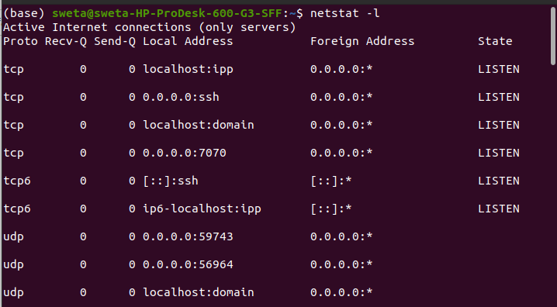
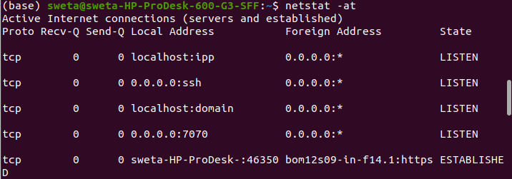
Types of Netstat command
netstat -l: It is the command to display all active network connections.
netstat -at: It is the command to display all TCP connections.
Note: 1) 0.0.0.0 means that the program is listening on all IPv4 addresses assigned to the machine.
2) 0.0.0.0:* in netstat output means that ssh daemon is listening on all IPv4 interfaces the machine has.
3) [::]:* means it is listening on all IPv6 interfaces.

Slide 9
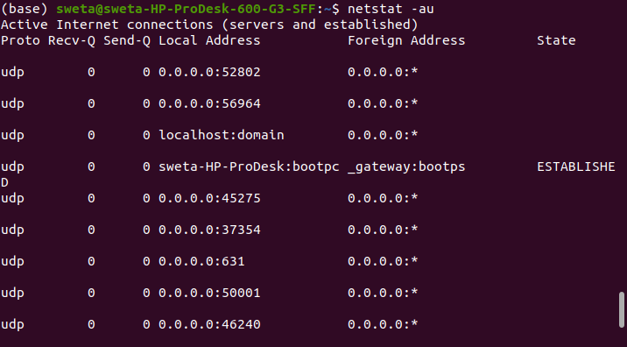
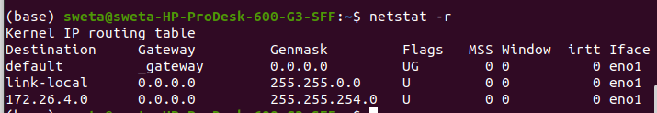
Cont..
3) netstat -au: It is the command to display all UDP connections.
4) netstat -r: It is used to display kernel routing tables.
Note: 1) Flags Indicating the current status of the route.
E.g., The U flag indicates that the route is up. The G flag indicates that the route is to a gateway. The UG flags mean that the route is UP and that the destination is a network not directly connected to this interface.
2) MSS stands for the Maximum Segment Size and is the size of the largest datagram the kernel will construct for transmission via this route. The Window is the maximum amount of data the system will accept in a single burst from a host.
3) The acronym irtt stands for initial round trip time. irtt ensures that data is reliably delivered between hosts by retransmitting a datagram if it has been lost.
4) The Iface column tells which network interface should be used for sending packets that match the destination.

Slide 10
Hostname
hostname command is used to know the DNS i.e. domain name of the server.
Using this command we can also change the name of the system.
This is a name that is uniquely given to the computer or network device.
This name is very helpful for the identification of the host in the network.
Using this command, we can alter the DNS name of the server anytime.

Slide 11
Introduction to Wireshark

Slide 12
What is Wireshark
Wireshark is a Network packet analyzer.
It is a tool to analyze all the details of captured packet data.
In a way, Wireshark enables us to determine what is happening inside the network cable in use.
Wireshark is a free, open source and best packet analyzer tool available today.

Slide 13
Applications of Wireshark
Network administrators use it to troubleshoot network problems.
Developers use it to debug protocol internals.
Network security engineers use it to examine security problems.
Quality Assurance engineers use it to verify network applications.
Academic People use it to learn network protocol internals.

Slide 14
Features of Wireshark
Wireshark captures live packet data from a network interface.
Open files containing packet data captured with tcpdump/WinDump, Wireshark and other packet capture programs.
Import packets from text files containing hex dumps of packet data.
Display packets with detailed protocol information.
It can save packet data captured, filter packets, search for packets and export some or all packets in a number of capture file formats etc.

Slide 15
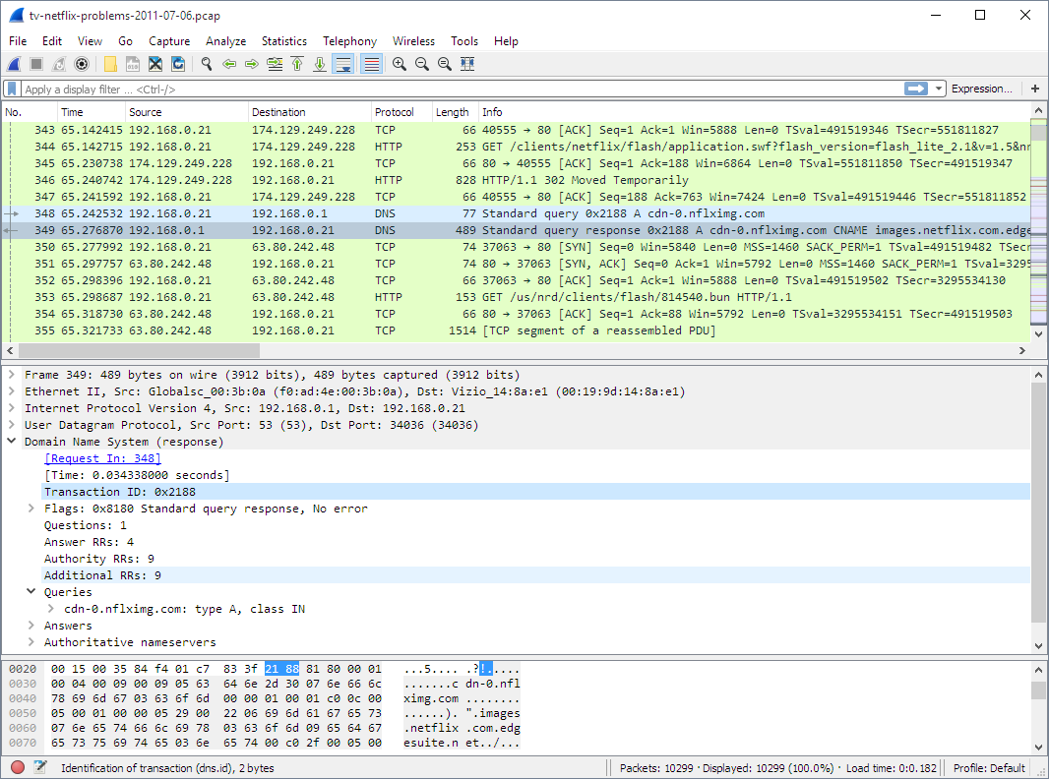
Wireshark Interface
Command Menu
Display filter specification
Highlighted packet
Listing of captured packets
Details of selected Packet headers
Highlighted packet also here
Packet content in hexadecimal and ascii

Slide 16
Live capture from different media
Wireshark can capture traffic from many different network media types:
Ethernet
Wireless LAN
Bluetooth
USB
The specific media types supported may be limited by factors including hardware and operating system.

Slide 17
Wireshark Installation
How to Install and Use Wireshark on Ubuntu (Linux) OS?
Note: Installation of Wireshark software in windows OS is a bit different from ubuntu OS. For installation you can follow the below link:
https://www.wireshark.org/download.html

Slide 18
Steps :
Steps to install Wireshark on Ubuntu (Linux) OS
To install the latest version of Wireshark on Ubuntu we have to follow certain steps:
Step 1: Go to the terminal by simply pressing Ctrl + Alt + t or right-click + Open in Terminal
Step 2: Type the following commands in the terminal

Slide 19
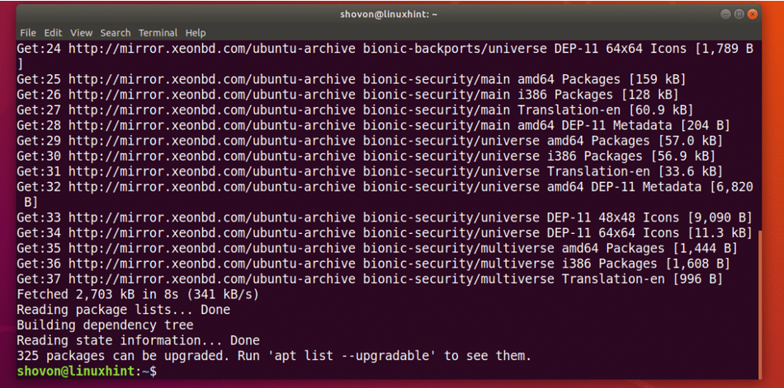
Update Apt Package
First update the APT package repository cache with the following command:
The APT package repository cache should be updated.

Slide 20
Installing Wireshark
Now, Run the following command to install Wireshark on your Ubuntu machine:

Slide 21
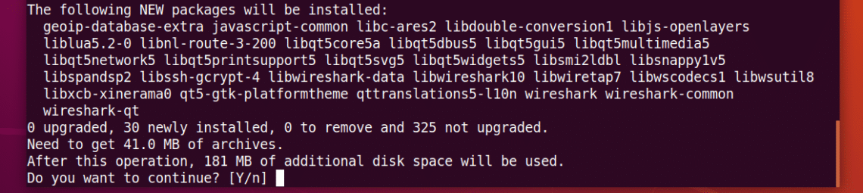
Further
Now press y and then press <Enter>

Slide 22
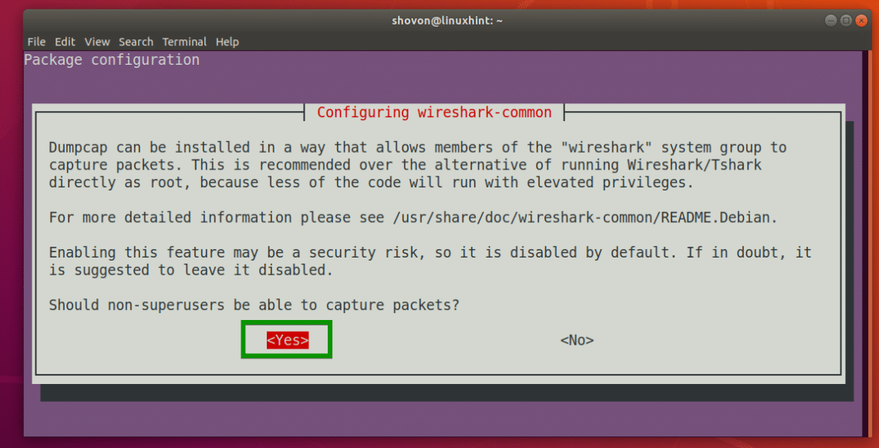
User Mode
By default, Wireshark must be started as root (can also be done with sudo) privileges in order to work. If you want to run Wireshark without root privileges or without sudo, then select <Yes> and press <Enter>.

Slide 23
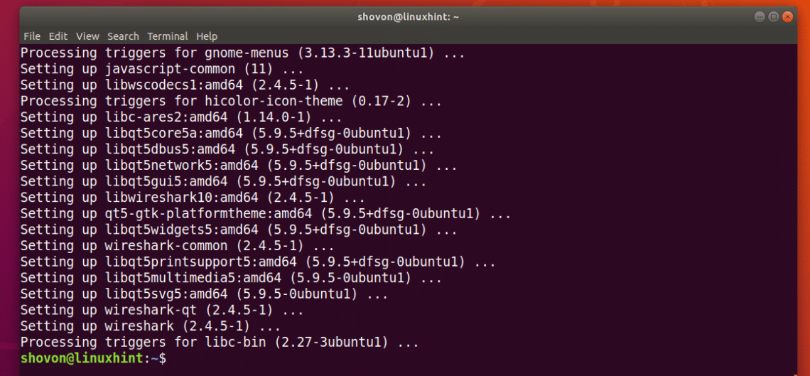
Installed
Wireshark should be installed.

Slide 24
Add User Group
Now if you selected <Yes> in the earlier section to run Wireshark without root access, then run the following command to add your user to the wireshark group:

Slide 25
Reboot
Finally, reboot your computer with the following command:

Slide 26
Run Wireshark
You can also run the following command to start Wireshark from the Terminal:
If you did not enable Wireshark to run with root privileges
Or sudo , then use the following command:

Slide 27
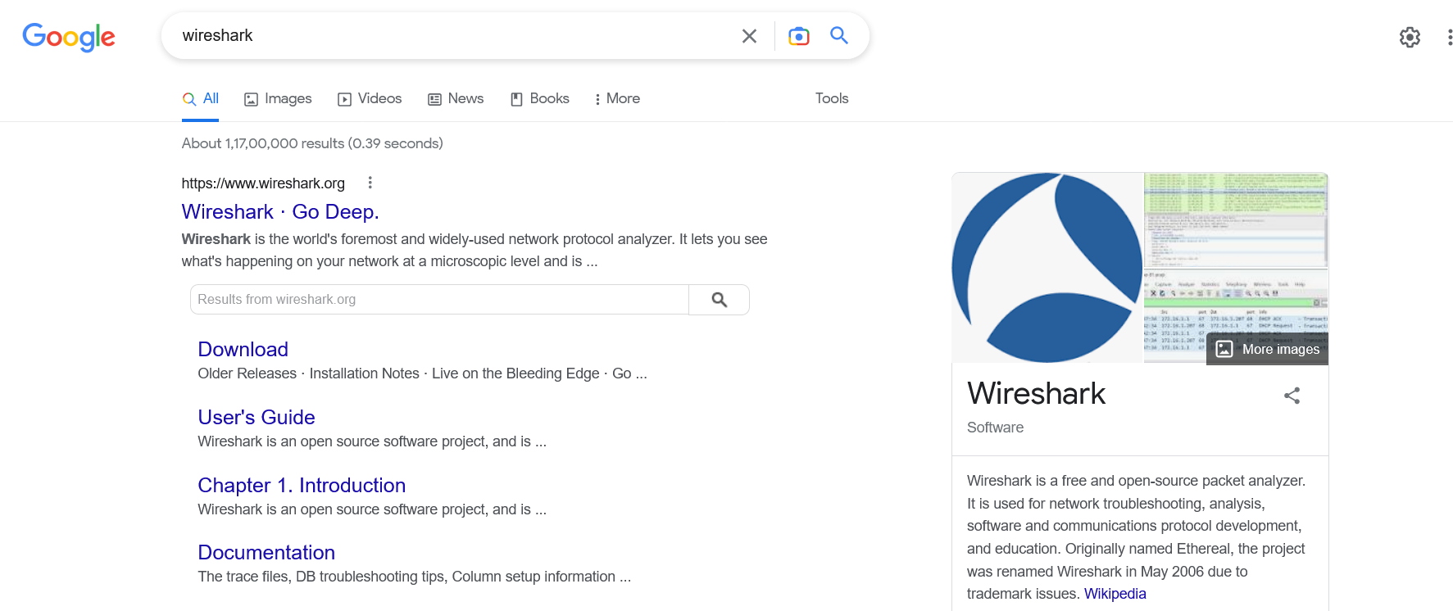
How to Install Wireshark on Windows?
Visit the official Wireshark Site using any web browser.

Slide 28
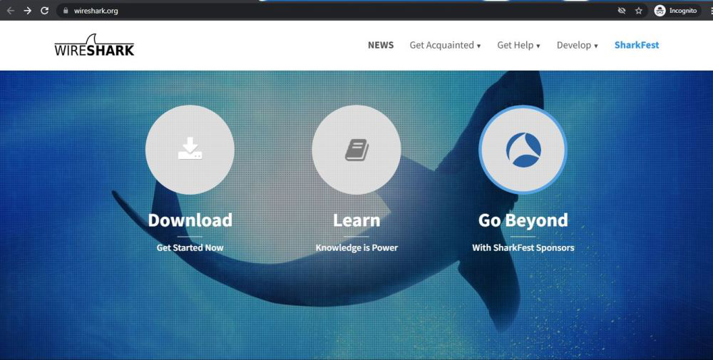
Download
Click on Download and new webpage will open with different releases and installers of Wireshark

Slide 29
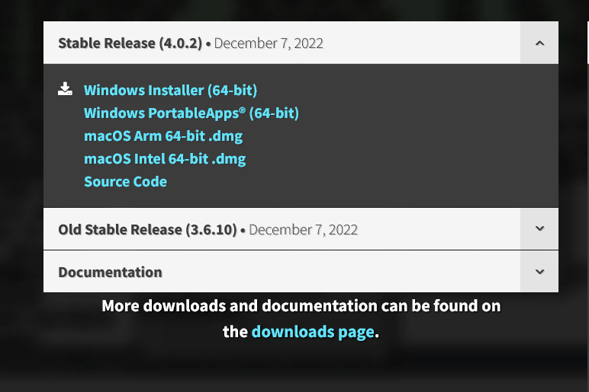
Version
Select the version of the installer matching your system. Here 64-bit windows os is used.

Slide 30
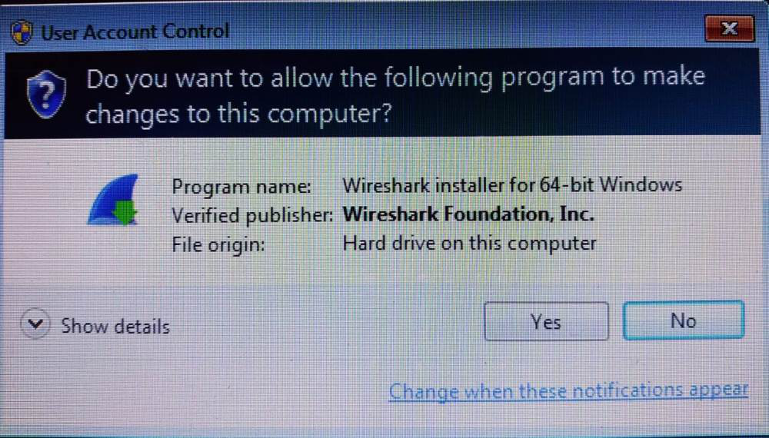
Executable File
Downloading of executable file will start shortly after clicking. Nearly ~ 75.1MB for 4.0.2
Now check for executable file in Downloads and run it.

Slide 31
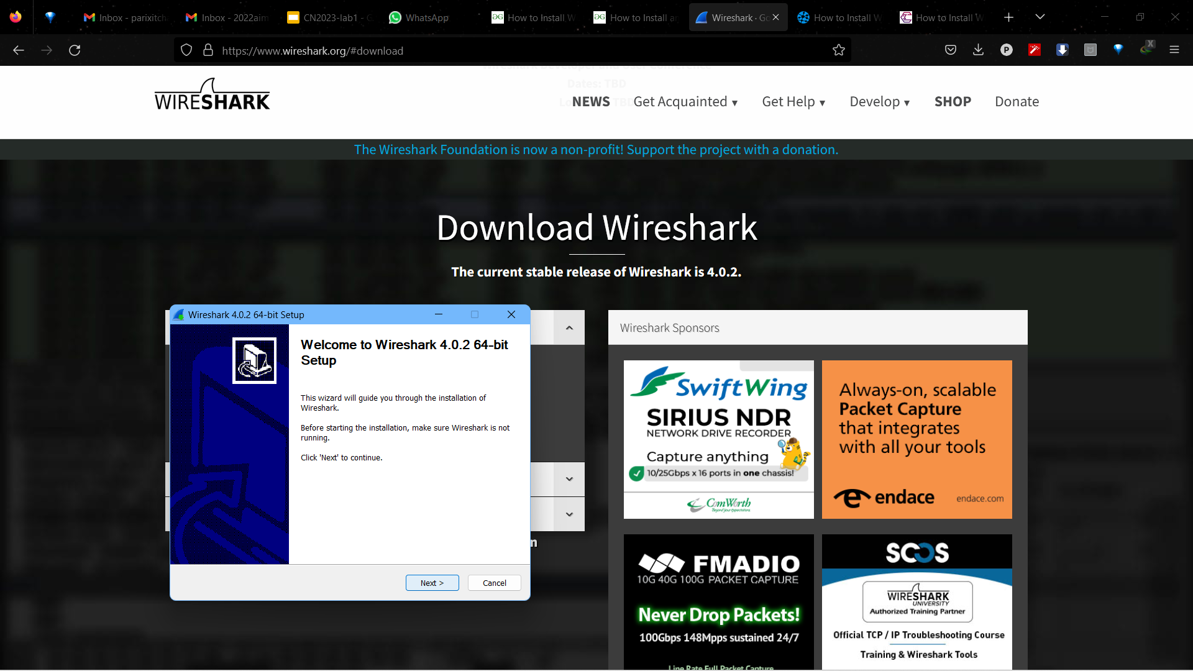
Run Setup
Setup screen will appear, click on Next.

Slide 32
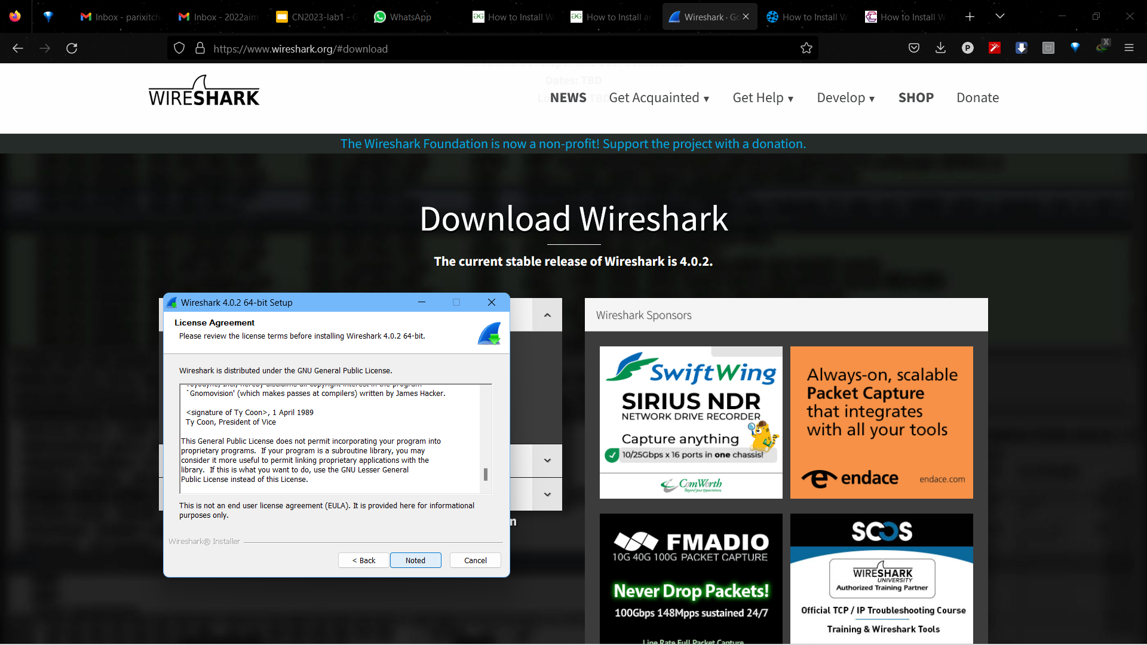
License
Click on Noted to proceed after reading LICENSE

Slide 33
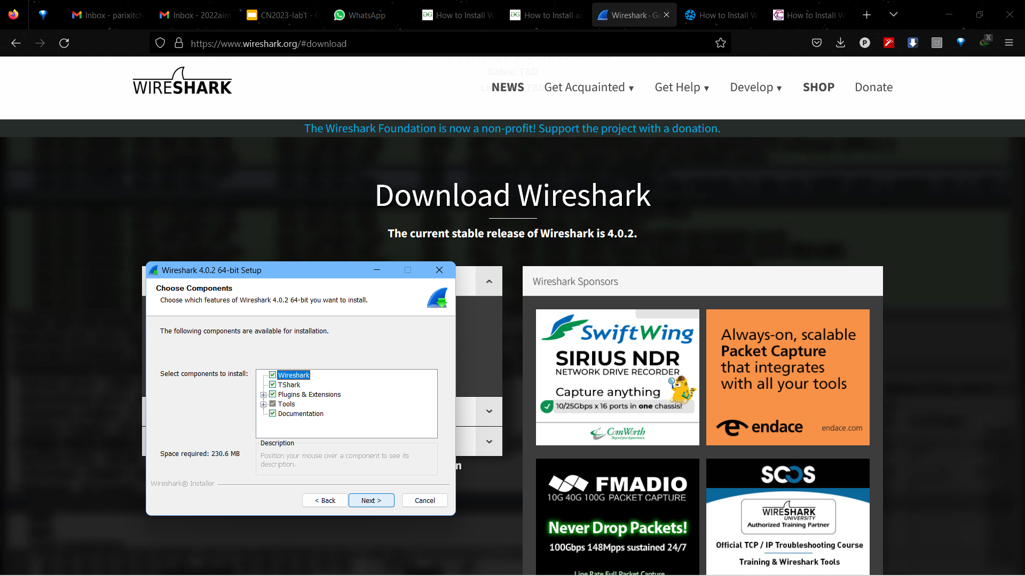
Choosing Components
This screen is for choosing components, so choose components and click on the Next button.

Slide 34
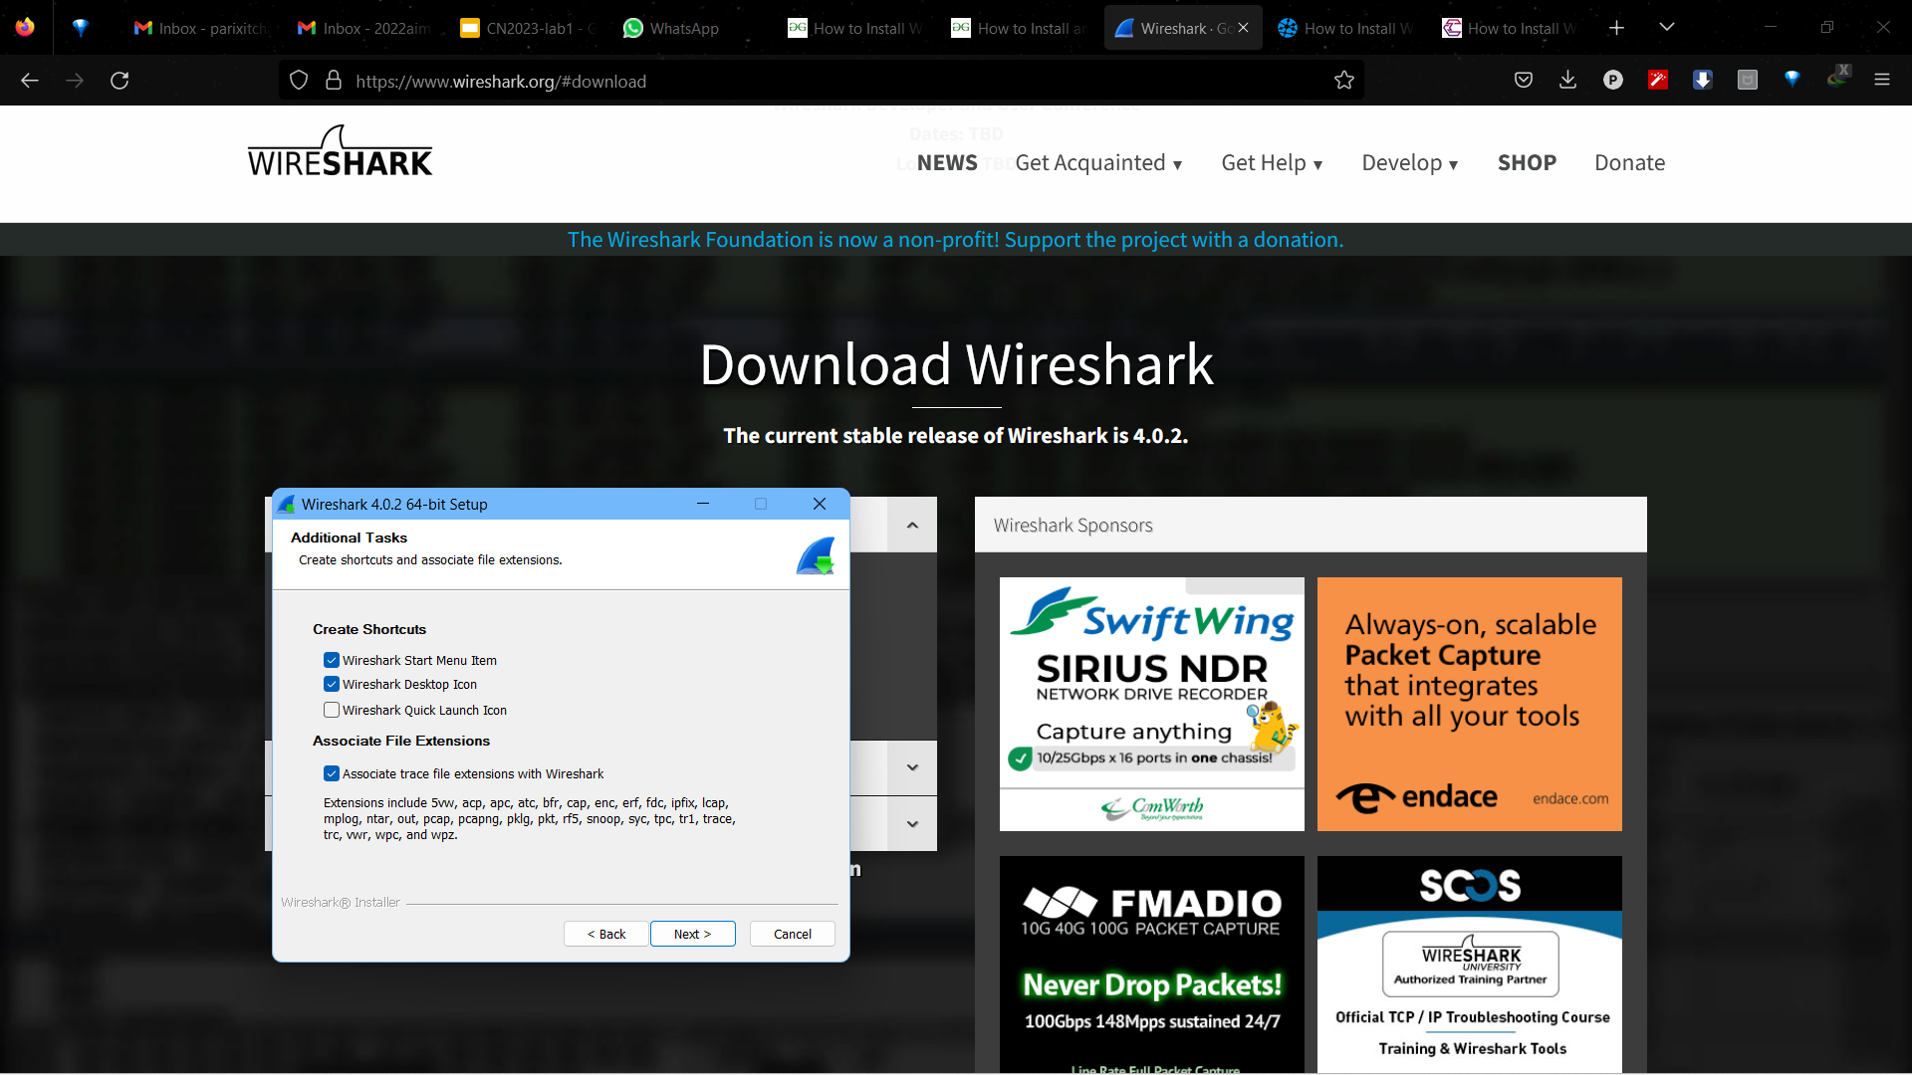
Shortcuts
This screen is of choosing shortcuts like start menu or desktop icon along with file extensions which can be intercepted by Wireshark, tick all desired boxes and click on Next button.

Slide 35
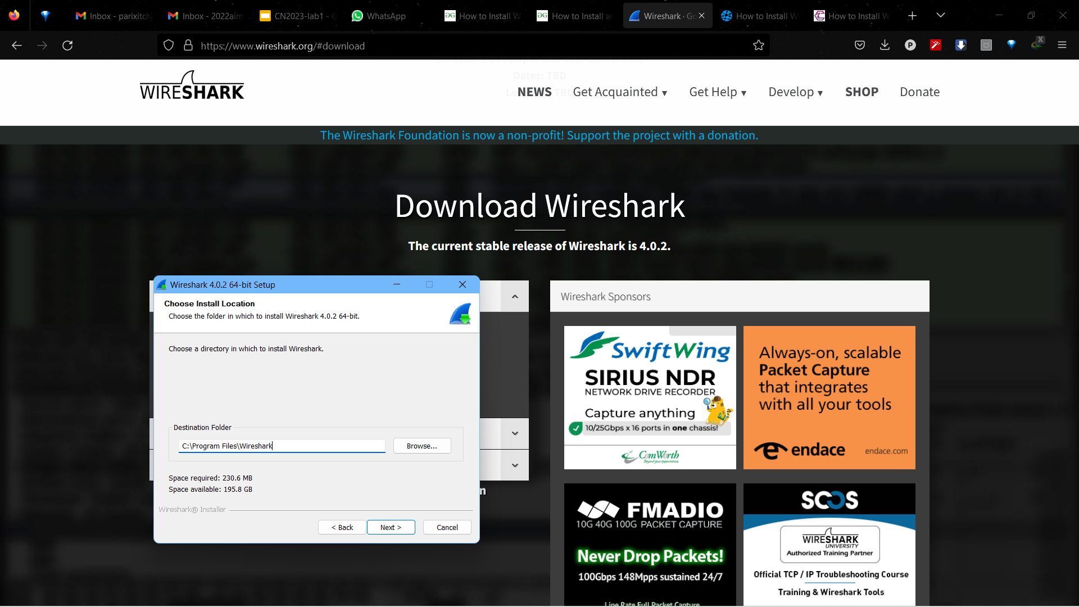
Install Location
The next screen will be of installing location so choose the drive which will have sufficient memory space for installation.

Slide 36
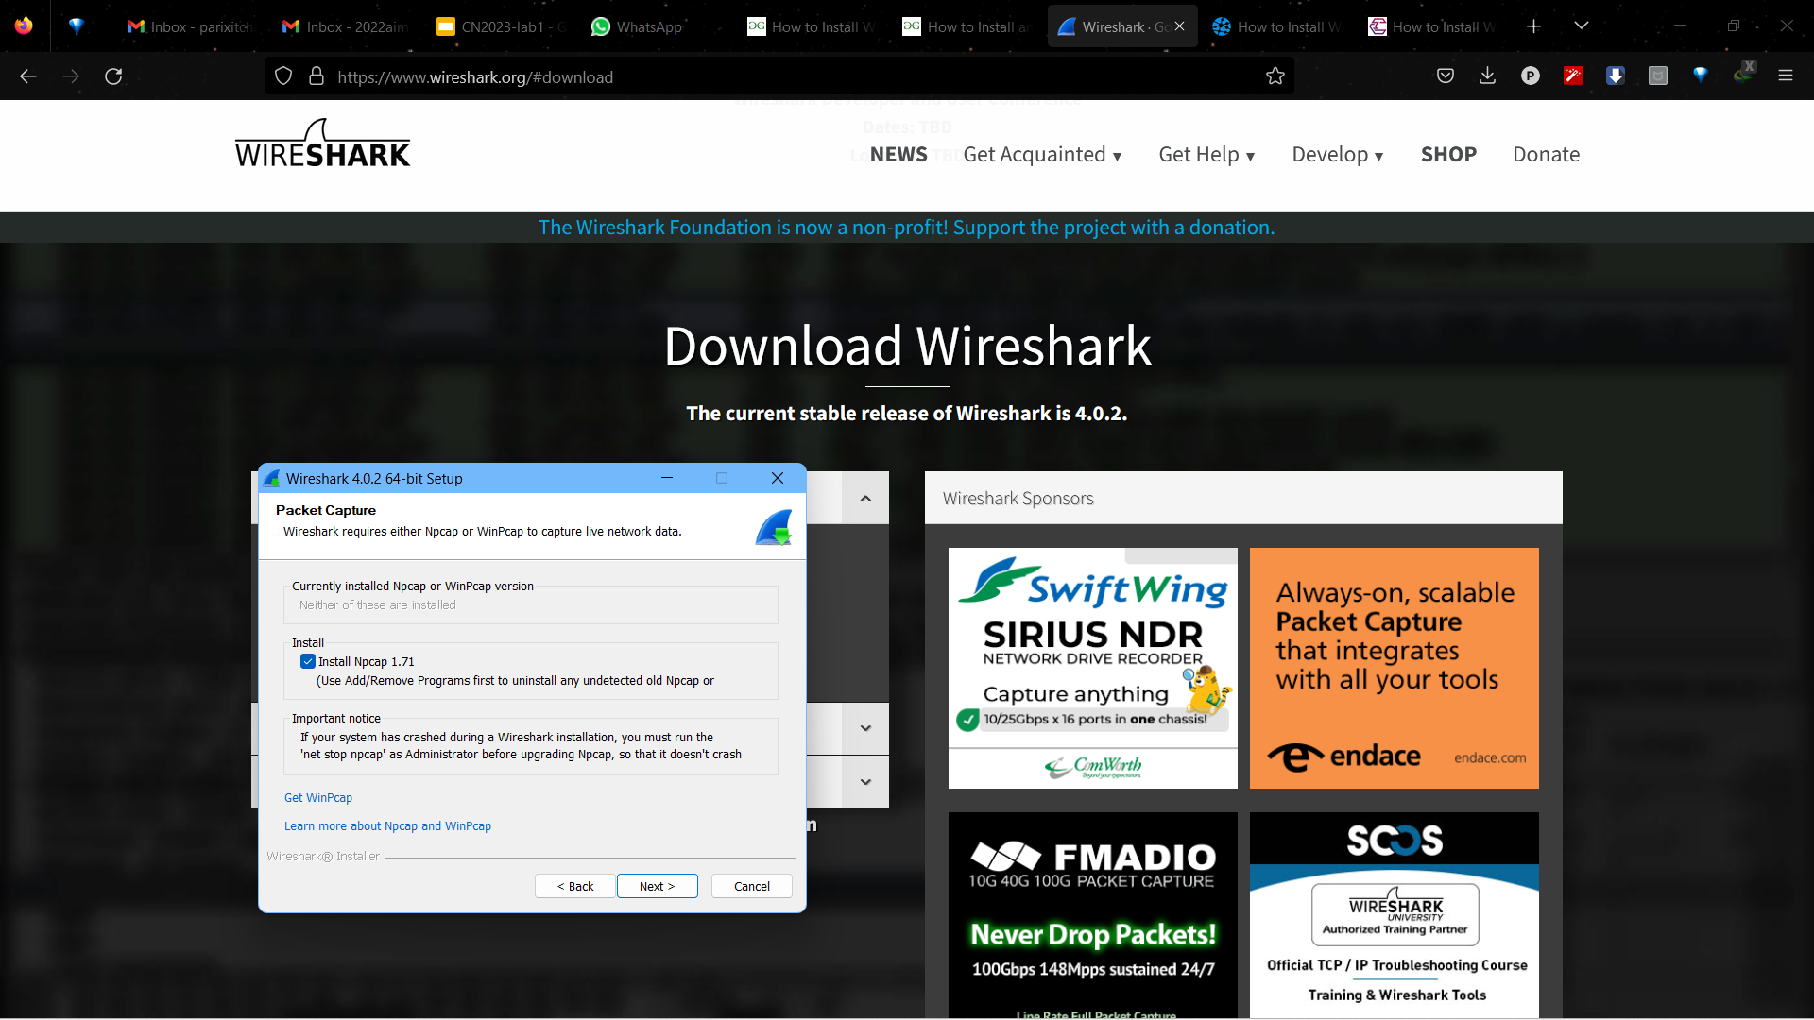
Installing NpCap
Next screen has an option to install Npcap which is used with Wireshark to capture packets pcap means packet capture so the install option is already checked don’t change anything and click the next button.

Slide 37

USB Capture
Next screen is about USB network capturing so it is one’s choice to use it or not, click on Install.

Slide 38
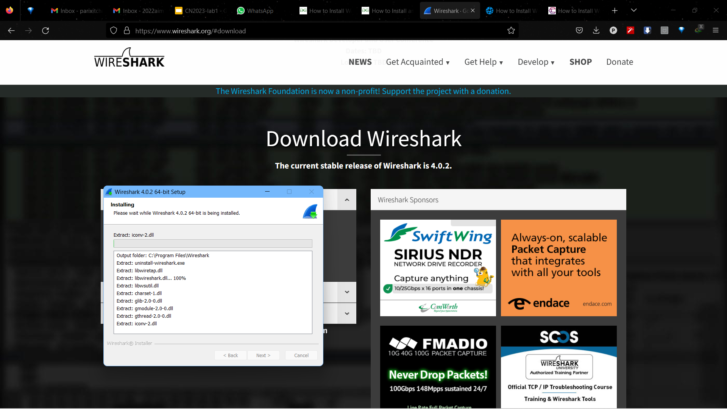
Installation
After this installation process will start.

Slide 39
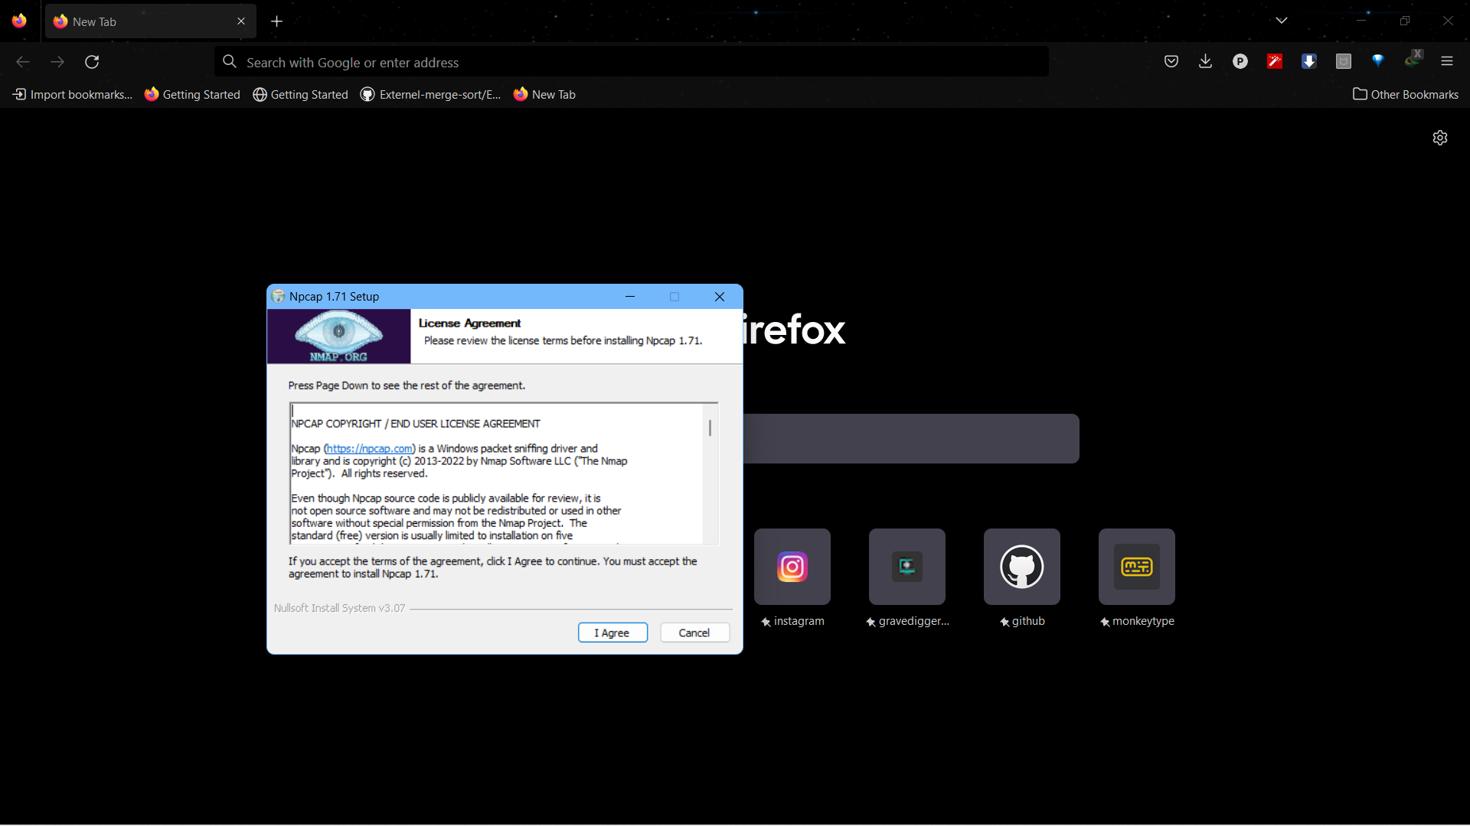
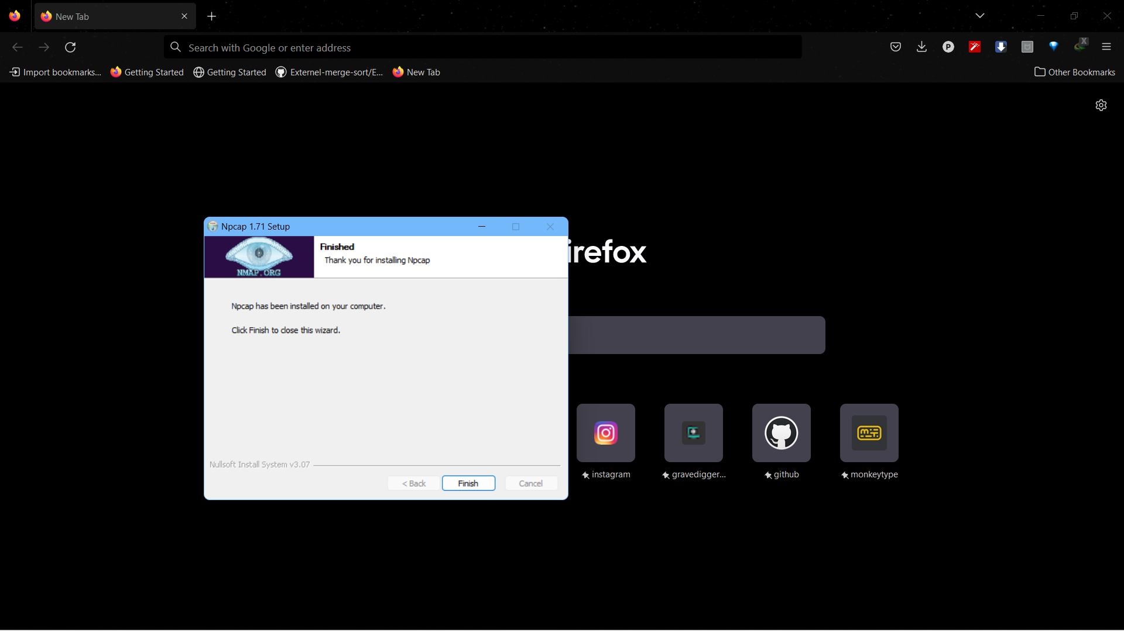
Cont..
This installation will prompt for Npcap installation as already checked so the license agreement of Npcap will appear to click on the I Agree button.

Slide 40
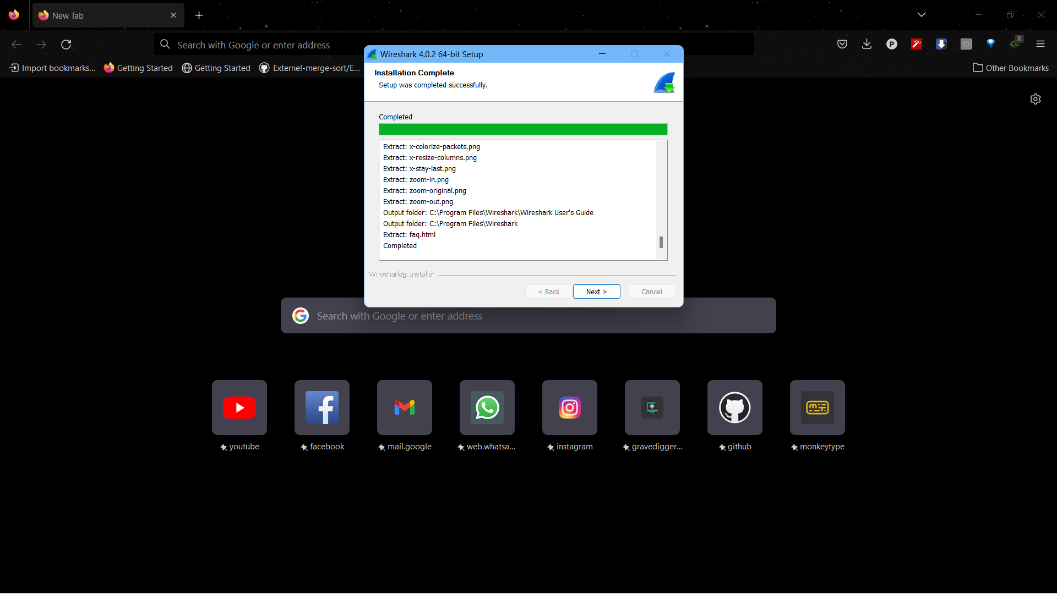
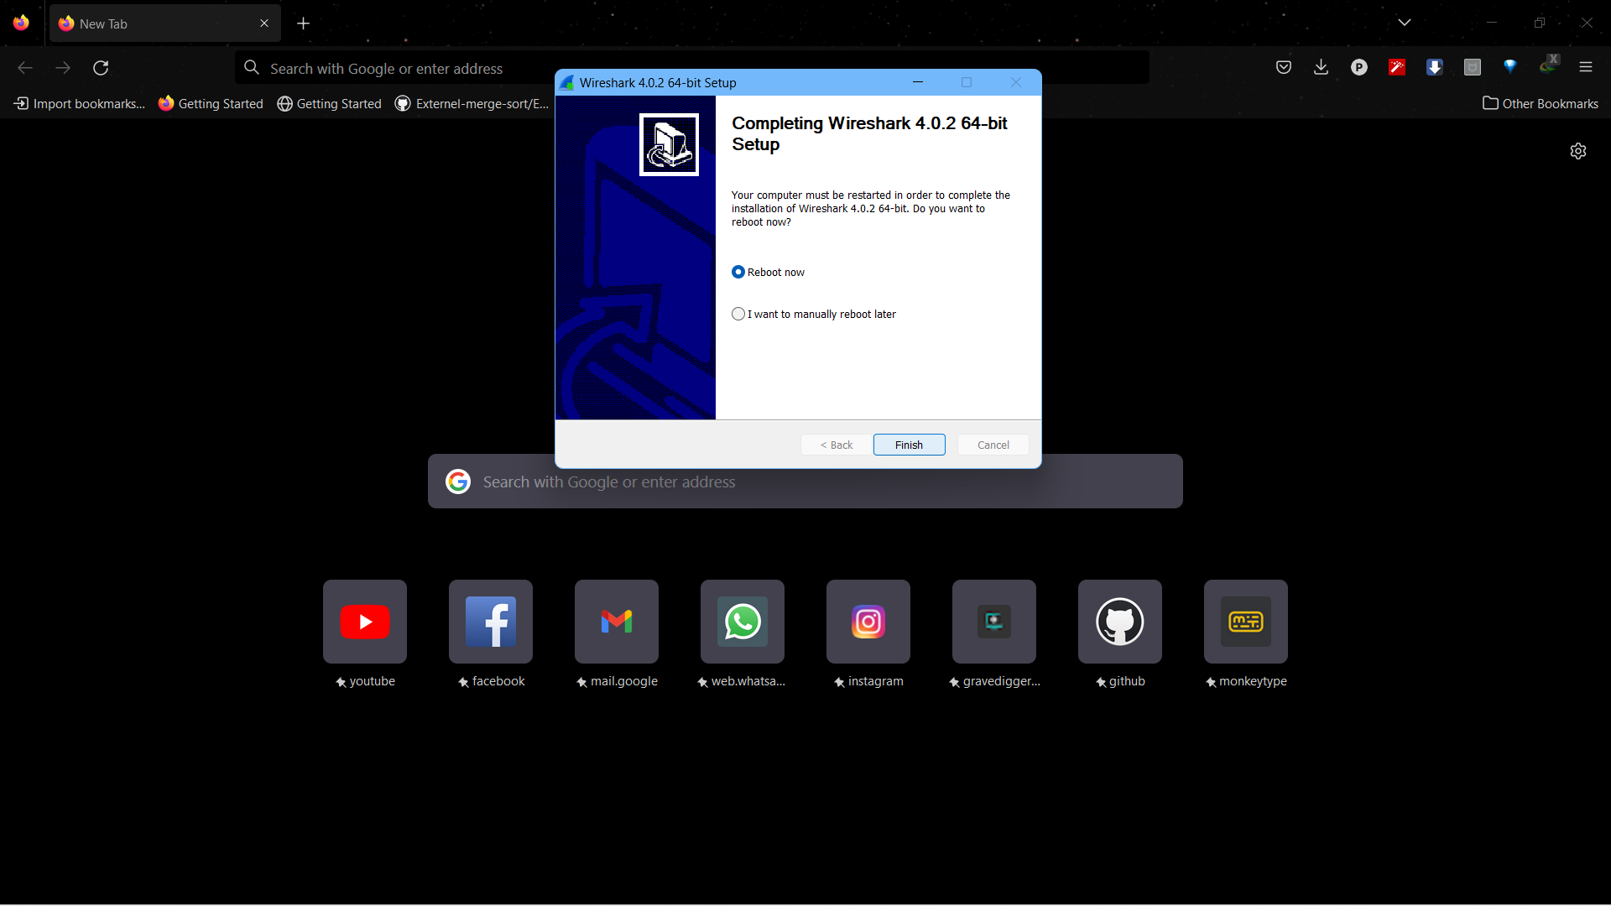
Finish Installation
Finish installation and click on reboot now.

Slide 41

Successful Installation
Wireshark is successfully installed on the system and an icon is created on the desktop as shown below:

Slide 42
Capturing Live Network Data

Slide 43
Prerequisites
Special privileges may be needed to start a live capture.
Choose right network interface to capture network data from.
Choose right place in the network to capture and see the network traffic.

Slide 44
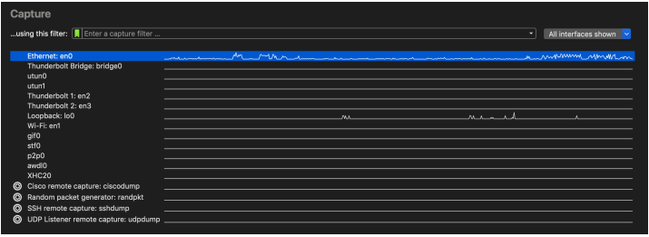
Start Capturing
Use following steps to start capturing packets with Wireshark
Double click on an interface in the welcome screen or select an interface and then, select Capture > Start.

Slide 45
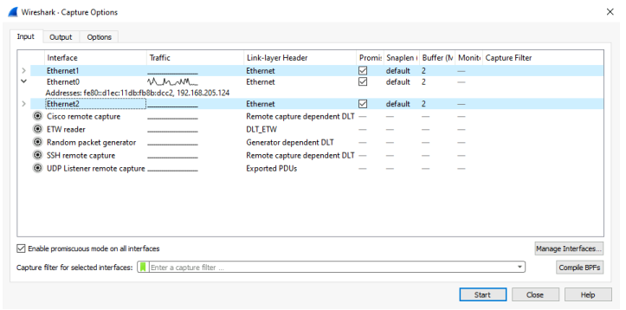
Cont..
2. You can get more detailed information about available interfaces using The Capture Options Dialog Box. select Capture > Options

Slide 46
Stop Capturing
A running capture session will be stopped in one of the following ways:
The Stop Capture button in the Capture Information dialog box.
The Capture › Stop menu item.
Pressing Ctrl + E.

Slide 47
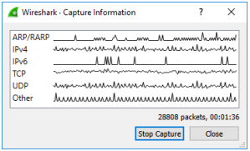
Cont..
3. The capture will be automatically stopped if one of the Stop Conditions is met, e.g., the maximum amount of data was captured.

Slide 48
More on Capture options(Input)
Interface: This column contains the interface name.
Traffic: A sparkline showing network activity over time.
Link-Layer Header: The type of packets captured by this interface.
Promiscuous: Used to put the interface in promiscuous mode.
Snaplen: The number of bytes to capture for each packet. Can be set to an explicit length.
Buffer: The size of the kernel buffer that is reserved for capturing packets. It can be increased or decreased.

Slide 49
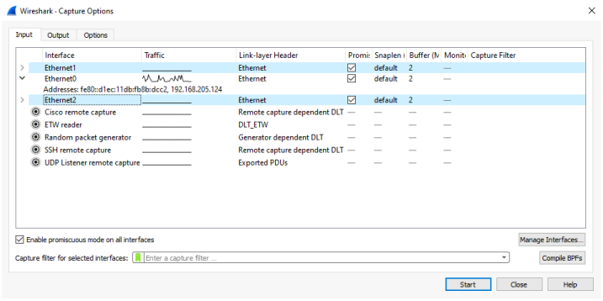
More on Capture options
7. Monitor mode: Lets us capture full, raw 802.11 headers. Support depends on interface type, hardware, driver, etc.
8. Capture filter: The capture filter applied to this interface.

Slide 50
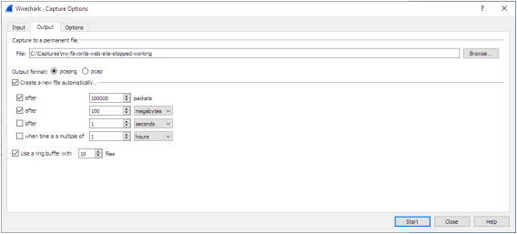
More on Capture options (Output)
File: This field allows you to specify the file name that will be used for the capture file.
Output format: Allows you to set the format of the capture file. pcapng is the default and is more flexible than pcap.

Slide 51
More on Capture options (options)
Update list of packets in real time: Updates packet list pane in real time during capture.
Automatic scroll during live capture: Scroll the packet list pane as new packets come in, so you are always looking at the most recent packet.
Resolve MAC addresses: Translate MAC address into names.

Slide 52
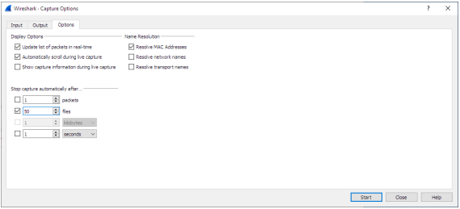
More on Capture options (options)
4. Resolve network names: Translate network addresses into names.
5. Resolve transport names: Translate transport names (port numbers)

Slide 53
Filtering while Capturing
Wireshark supports limiting the packet capture to packets that match a capture filter.
Wireshark capture filters are written in libpcap filter language.
You enter the capture filter into the Filter field of the Wireshark Capture Options dialog box

Slide 54
Capture Filter
The capture filter takes the form of a series of primitive expressions connected by conjunctions (and/or) and optionally preceded by not.
Example: [not] primitive [and|or [not] primitive …]
Example of capture filter for telnet that captures traffic to and from a host.
tcp port 23 and host 10.0.0.5

Slide 55
Cont..
The previous example captures telnet to and from the host 10.0.0.5, and shows how to use two primitive and the conjunction.
A primitive is simply one of the following:
[src|dst] host <host>: This primitive allows you to filter on a host IP address or name.
ether [src|dst] host <ehost>: This primitive allows you to filter on Ethernet host addresses.
gateway host <host>: This primitive allows you to filter on packets that used host as a gateway.

Slide 56
Cont..
[src|dst] net <net> [{mask <mask>}|{len <len>}]: This primitive allows us to filter on network number.
[tcp|udp][src|dst] port <port>: This primitive allows us to filter on TCP and UDP port numbers.
less|greater <length>: This primitive allows us to filter on packets whose length less than or equal to the specified length
Ip|ether proto <protocol>: This primitive allows us to filter on the specified protocol at either Ethernet layer or IP layer.
ether|ip broadcast|multicast: This primitive allows us to filter on either Ethernet or IP broadcasts or multicasts.

